Slide 1

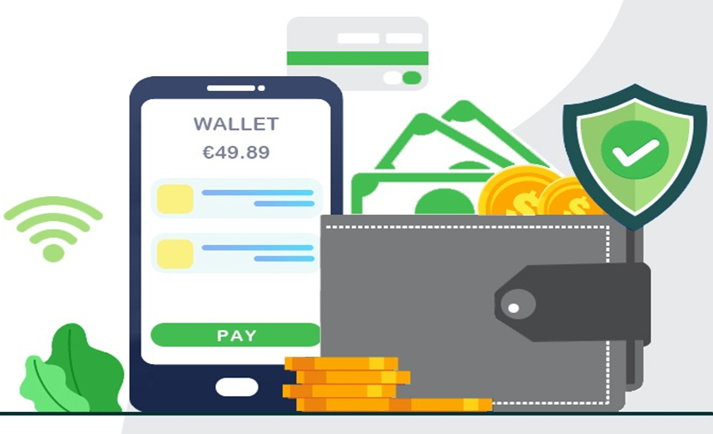
Presented By:
The Maharaja Sayajirao University Of Baroda Faculty Of Science Department Of Statistics
Statistical Analysis of digital payment on the students of science faculty
Dhruvi Sheth
Hardik parmar
Mahek Parmar
Neelu kanwar
Waheedullah stanikzai
Guide By :
Dr. (Mrs.) Khimiya Tinani

Slide 2
01
INTRODUCTION
02
REVIEW OF LITERATURE
03
OBJECTIVES
TABLE OF
CONTENTS
04
SAMPLING METHODOLOGY
05
DATA VISUALIZATION
06
STATISTICAL ANALYSIS
07
CONCLUSION
REFERENCE
08

Slide 3
Introduction
The arrival of development in technology in the worldwide business environment had challenged almost all organizations to shift from traditional paper currency to digital payment platforms which is commonly known as digital payment or e-payment system.
Digital payment can be defined as platform which is used for making monetary transaction for various goods or services purchased over the internet.
Digital payment not only provides the e-commerce or e-business with advance money but it brings in efficiency ,reduced cheat activities and its adding on to the new innovation in the payment system across the global.

Slide 4
Review of Literature
Oladejo, Morufu et.al (2012) in their study examined the improvement of e-payment system in Nigeria. They explored what initiated the people to adopt the e-payment system. A structured questionnaire and some financial statements were collected to analyse the data.
Nitsure (2014) in his study highlighted the issues that were being faced or observed in developing country like India in using the e-payment system which was due to the low spread of internet and technology. The paper focused on major issues such as security, rules, etc.
Bezhovski (2016) has examined how internet and e-commerce has opened the gateway for digital payment system with the increment in technology . The future of these digital wallets will depend on the security and privacy that are provided by the companies.

Slide 5
Objectives
To study the association between uses of digital payments and demographic variables.
To study why would you adopt digital payment.
To study biggest concern while using digital-payments.
To study the choice of application used for digital payment.
To study the uses of digital payment in different places.
To study what influenced students to use digital payment.
To study the impact of covid- 19 on digital payment.
To study the factors which affect to never use digital- payment.

Slide 6
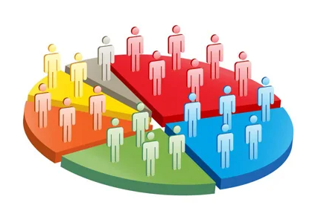
Sampling Methodology
Target population:
The students who are currently study in(2020-2021) Faculty Of Science at The Maharaja Sayajirao University Of Baroda.
Sampling frame:
Under graduate and post graduate students from each department.
Sampling techniques:
Two stage sampling :
Stratified sampling department wise.
Sample will be collected by SRS.

Slide 7
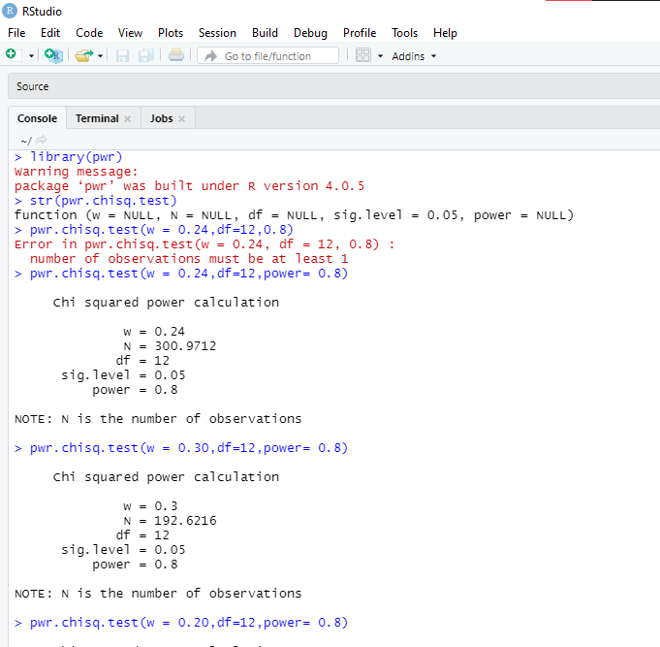
For convenience, here are all conventional effect sizes for all tests in the pwr package:
SAMPLE SIZE DETERMINATION:
Using power package in R for each objective of our study we have determine sample size corresponding to the appropriate statistical tool.
Test | small | medium | large
tests for proportions (p) | 0.2 | 0.5 | 0.8
tests for means (t) | 0.2 | 0.5 | 0.8
chi-square tests (chisq) | 0.1 | 0.3 | 0.5
correlation test (r) | 0.1 | 0.3 | 0.5
anova (anov) | 0.1 | 0.25 | 0.4
general linear model (f2) | 0.02 | 0.15 | 0.35

Slide 8

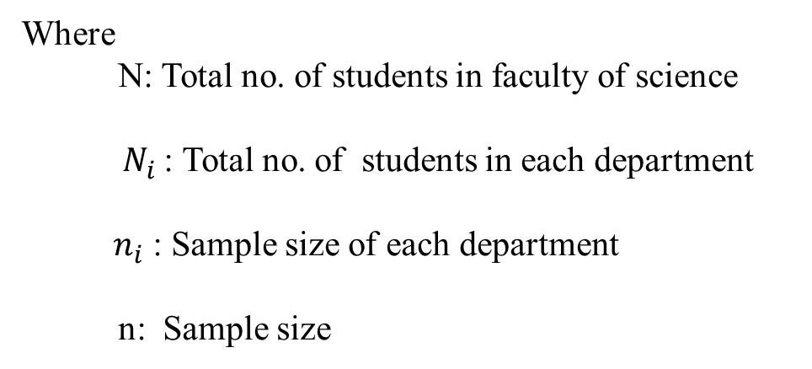
Departments | Ni | ni | Round off
Microbiology | 56 | 3.751614 | 4
Physics | 516 | 34.56844 | 35
Medical biotechnology | 39 | 2.612731 | 3
Chemistry | 517 | 34.63543 | 35
Botany | 376 | 25.18941 | 25
Biochemistry | 54 | 3.617627 | 4
Statistics | 352 | 23.58157 | 24
Mathematics | 702 | 47.02916 | 47
Zoology | 369 | 24.72045 | 25
Geology | 340 | 22.77765 | 23
Geography | 260 | 17.41821 | 17
Environmental science | 342 | 22.91164 | 23
Information & Technology | 46 | 3.081683 | 3
Biotechnology | 36 | 2.411752 | 2
Cell & molecular | 124 | 8.307144 | 8
Computer application | 364 | 24.38549 | 24
N | 4493 |  | 302
Sample size determination by using proportional stratified sampling for each strata(Department)
$$n_{i}=\frac{n_{\left(srswor\right)}N_{i}}{N}$$
Where
N: Total no. of students in faculty of science
${ N}_{i}$: Total no. of students in each department
${ n}_{i}$: Sample size of each department
n: Sample size

Slide 9
Reliability Analysis
Reliability in statistics is the overall consistency of a measure.
Cronbach’s alpha is a measure of internal consistency, that is, how closely related a set of items are as a group. It is considered to be a measure of scale reliability. The α coefficient for the 30 items is 0.700, suggesting that the items have relatively high internal consistency. The reliability coefficient of .70 or higher is considered “acceptable” in most social science research situations. Thus , for α=0.700 , our questionnaire is Acceptable, hence valid and reliable for this study.(refer to table.)
Cronbach Alpha | Internal Consistency
α >= 0.9 | Excellent
0.9 > α >= 0.8 | Good
0.8 > α >= 0.7 | Acceptable
0.7 > α >= 0.6 | Questionable
α <= 0.6 | Poor
Reliability Statistics
Cronbach's Alpha | N of Items
0.700 | 38

Slide 10
Data Visualization:
Gender wise distribution of students
In our survey we have 47% male and 53 % female students.

Slide 11
Current Scenario of Digital Payment Usage
Gender wise comparison of uses of digital payment
Here we observe that we have 88% users and 12 % Non-users of Digital payment
Here we observe that 82% of Female use digital Payment and 94% of male use digital payment.
.

Slide 12
Income wise Uses of digital payment.
Reasons for adopting a digital payment system
From the above graph we observe that digital payment is mostly used by the students whose annual family income lies between 90 thousand – 3 lakhs..
Here we observe that the most important factor determining the usage of digital payment is time saving followed by convenience.

Slide 13
Use digital payments at different places
Use digital payments at different places
Here we observe that 77% students use digital payment for mobile phone recharge and for paying fees.

Slide 14
Online Payment Application Usage Criteria
Here it is observed that 77% of students use Google Pay whereas 59% students use Paytm.

Slide 15
Reasons for Influence towards online payments
It can be noticed that 57% influence are through friends and followed by family(54%).

Slide 16
Biggest concern while using digital payment
From the above graph we observe that maximum number of students are agree by the fact that Fraud and privacy is the biggest concern while using digital payment.

Slide 17
Impact of Covid-19
How safe is digital payment based on scaling
From the above graph we observe that due to this pandemic 8 % of students adopted the mode of digital payment.
Here we observe that 51.00% of students agree that digital payment is safe.

Slide 18
Experience of facing fraud while using digital payment
From the above graph we observe that 14% of students facing fraud while using digital payment

Slide 19
Reasons for not Using Digital payment
Usages of digital payment in future
Here we observe that 51.0% of students are not using digital payment, due to concern about security and followed by given reason.
Here we observe that the students who currently not using digital payment, 97% of them will use in future.

Slide 20
Statistical Analysis
1) Objective: To check the association between gender and usages of digital payment.
H0: There is no association between gender and usages of digital payments.
H1: There is association between gender and usages of digital payments.
Gender vs. Use of Digital payment methods Crosstabulation
 |  |  | Do You Use Digital payment methods? |  | Total
 |  |  | No | Yes
Gender | Female | Count | 28 | 132 | 160
 |  | Expected Count | 19.6 | 140.4 | 160.0
 | Male | Count | 9 | 133 | 142
 |  | Expected Count | 17.4 | 124.6 | 142.0
Total |  | Count | 37 | 265 | 302
 |  | Expected Count | 37.0 | 265.0 | 302.0
Chi-Square Tests
 | Value | df | Asymptotic Significance (2-sided)
Pearson Chi-Square | 8.719ª | 1 | 0.003
N of Valid Cases | 302
a. 0 cells (0.0%) have expected count less than 5. The minimum expected count is 17.40.
b. Computed only for a 2x2 table
Conclusion:
p value < 0.05(α) so we reject null hypothesis.
Hence we conclude that there is association between gender and usage of digital payments.

Slide 21
As there is association between two attributes, i.e. gender and usages of digital payment. Then how much?
Hence for that we use Tschuprow’s test.
Symmetric Measures
 |  | Value | Approximate Significance
Nominal by Nominal | Phi | 0.170 | 0.003
 | Cramer's V | 0.170 | 0.003
N of Valid Cases |  | 302
Conclusion:
T̂ =0.170
Thus there is 17.0% association between gender and usages of digital payment.

Slide 22
2) Objective: To check association between income and usages of digital payment.
H0: There is no association between income and digital payment.
H1: There is association between income and digital payment
Annual family income Vs. Use Digital payment methods Crosstabulation
 |  |  | Do You Use Digital payment methods? |  | Total
 |  |  | No | Yes
Annual family income | Below 90,000 | Count | 9 | 79 | 88
 |  | Expected Count | 10.8 | 77.2 | 88.0
 | Between 90,000 to 3 lakhs | Count | 14 | 101 | 115
 |  | Expected Count | 14.1 | 100.9 | 115.0
 | Between 3 lakhs to 7 lakhs | Count | 10 | 58 | 68
 |  | Expected Count | 8.3 | 59.7 | 68.0
 | Above 7 lakhs | Count | 4 | 27 | 31
 |  | Expected Count | 3.8 | 27.2 | 31.0
Total |  | Count | 37 | 265 | 302
 |  | Expected Count | 37.0 | 265.0 | 302.0

Slide 23
Chi-Square Tests
 | Value | df | Asymptotic Significance (2-sided)
Pearson Chi-Square | .729ª | 3 | 0.866
N of Valid Cases | 302
a. 1 cells (12.5%) have expected count less than 5. The minimum expected count is 3.80.
Conclusion:
As p-value > α(0.05), therefore we do not reject our null hypothesis at 5% level of significance and hence we conclude that There is no association between income and usages of digital payment.

Slide 24
Multiple response chi-square test
1) Objective: To check association between gender and adoption of digital payment
Ho: There is no association between gender and adoption of digital payment
H1: There is association between gender and adoption of digital payment
 |  | Gender
 |  | Female |  | Male
 |  | Count | Column N % | Count | Column N %
why adopt? | Convenience | 81 | 61.4% | 101 | 75.9%
 | Discounts/cashback rewards | 43 | 32.6% | 60 | 45.1%
 | Time saving | 101 | 76.5% | 95 | 71.4%
 | Safe in this pandemic | 92 | 69.7% | 82 | 61.7%
 | Security | 55 | 41.7% | 60 | 45.1%
 | Easiness | 76 | 57.6% | 70 | 52.6%

Slide 25
Pearson Chi-Square Tests
 |  | Gender
why adopt? | Chi-square | 14.691
 | df | 6
 | Sig. | .023*
Results are based on nonempty rows and columns in each innermost subtable.
*. The Chi-square statistic is significant at the .05 level.
Conclusion:
Since p-value < α(0.05), therefore the data provides the enough evidence to reject Ho at 5% level of significant and 6 degree of freedom. Hence we conclude that there is association between gender and adoption of digital payment

Slide 26
2) Objective: To check association between gender and place where you use digital payment.
Ho: There is no association between gender and place where you use digital payment.
H1: There is association between gender and which place where you use digital payment.
 |  | Gender
 |  | Female |  | Male
 |  | Count | Column N % | Count | Column N %
place at which students use digital payment | Ticket booking | 81 | 61.4% | 93 | 69.9%
 | Bill payments | 93 | 70.5% | 88 | 66.2%
 | Paying fee | 99 | 75.0% | 105 | 78.9%
 | Mobile phone recharge | 98 | 74.2% | 106 | 79.7%
 | Petrol pump | 47 | 35.6% | 63 | 47.4%
 | Grocery store | 60 | 45.5% | 70 | 52.6%
 | Online shopping | 102 | 77.3% | 90 | 67.7%
 | Food payment | 55 | 41.7% | 55 | 41.4%
 | Investment | 14 | 10.6% | 44 | 33.1%
 | Insurance | 20 | 15.2% | 26 | 19.5%

Slide 27
Pearson Chi-Square Tests
 |  | Gender
place at which students use digital payment | Chi-square | 33.086
 | df | 10
 | Sig. | .000*
Results are based on nonempty rows and columns in each innermost subtable.
*. The Chi-square statistic is significant at the .05 level.
Conclusion:
Since p-value < α(0.05), therefore the data provides the enough evidence reject Ho at 5% level of significant and 10 df. Hence we conclude that There is association between gender and place where you use digital payment.

Slide 28
3) Objective: To check association between places and reasons for adoption of digital payment
H0: There is no association between places and reasons for adoption of digital payment.
H1: There is association between places and reasons for adoption of digital payment.
 |  | Reasons for adopt?
 |  | Convenience |  | Discounts/cashback rewards |  | Time saving |  | Safe in this pandemic |  | Security |  | Easiness
 |  | Count | Column N % | Count | Column N % | Count | Column N % | Count | Column N % | Count | Column N % | Count | Column N %
place at which students use digital payment | Ticket booking | 129 | 70.9% | 71 | 68.9% | 132 | 67.3% | 116 | 66.7% | 84 | 73.0% | 106 | 72.6%
 | Bill payments | 129 | 70.9% | 64 | 62.1% | 139 | 70.9% | 120 | 69.0% | 81 | 70.4% | 114 | 78.1%
 | Paying fee | 148 | 81.3% | 83 | 80.6% | 152 | 77.6% | 139 | 79.9% | 99 | 86.1% | 119 | 81.5%
 | Mobile phone recharge | 144 | 79.1% | 72 | 69.9% | 159 | 81.1% | 137 | 78.7% | 83 | 72.2% | 121 | 82.9%
 | Petrol pump | 79 | 43.4% | 40 | 38.8% | 81 | 41.3% | 81 | 46.6% | 60 | 52.2% | 60 | 41.1%
 | Grocery store | 99 | 54.4% | 52 | 50.5% | 100 | 51.0% | 96 | 55.2% | 68 | 59.1% | 76 | 52.1%
 | Online shopping | 136 | 74.7% | 76 | 73.8% | 142 | 72.4% | 128 | 73.6% | 85 | 73.9% | 114 | 78.1%
 | Food payment | 78 | 42.9% | 42 | 40.8% | 78 | 39.8% | 78 | 44.8% | 54 | 47.0% | 63 | 43.2%
 | Investment | 51 | 28.0% | 27 | 26.2% | 38 | 19.4% | 38 | 21.8% | 38 | 33.0% | 29 | 19.9%
 | Insurance | 34 | 18.7% | 15 | 14.6% | 30 | 15.3% | 33 | 19.0% | 21 | 18.3% | 25 | 17.1%

Slide 29
Pearson Chi-Square Tests
 |  | Reasons for adopt?
place at which students use digital payment | Chi-square | 182.398
 | df | 60
 | Sig. | .000*
Results are based on nonempty rows and columns in each innermost subtable.
*. The Chi-square statistic is significant at the .05 level.
Conclusion:
Here P-value is < α(0.05), so data provide enough evidence to reject Ho at 5% level of significant and 60 degree of freedom. Hence we conclude that there is association between places and reasons for adoption of digital payment.

Slide 30
4)Objective: To check association between applications and reasons for adoption of digital payment.
H0: There is no association between applications and reasons for adoption of digital payment.
H1: There is association between applications and reasons for adoption of digital payment.
 |  | Reasons for adopt?
 |  | Convenience |  | Discounts/cashback rewards |  | Time saving |  | Safe in this pandemic |  | Security |  | Easiness
 |  | Count | Column N % | Count | Column N % | Count | Column N % | Count | Column N % | Count | Column N % | Count | Column N %
application | Google pay | 147 | 80.8% | 82 | 79.6% | 153 | 78.1% | 138 | 79.3% | 96 | 83.5% | 115 | 78.8%
 | Paytm | 111 | 61.0% | 63 | 61.2% | 115 | 58.7% | 95 | 54.6% | 66 | 57.4% | 84 | 57.5%
 | phonepay | 76 | 41.8% | 49 | 47.6% | 88 | 44.9% | 81 | 46.6% | 51 | 44.3% | 61 | 41.8%
 | Amazon pay | 59 | 32.4% | 36 | 35.0% | 53 | 27.0% | 49 | 28.2% | 40 | 34.8% | 37 | 25.3%
 | Bhim | 67 | 36.8% | 41 | 39.8% | 53 | 27.0% | 55 | 31.6% | 44 | 38.3% | 41 | 28.1%
 | Other | 9 | 4.9% | 5 | 4.9% | 9 | 4.6% | 8 | 4.6% | 8 | 7.0% | 7 | 4.8%

Slide 31
Pearson Chi-Square Tests
 |  | Reasons for adopt?
application | Chi-square | 105.882
 | df | 36
 | Sig. | .000*
Results are based on nonempty rows and columns in each innermost subtable.
*. The Chi-square statistic is significant at the .05 level.
Conclusion:
Here P-value < α(0.05), so data provide enough evidence to reject Ho at 5% level of significant and 36 degree of freedom. Hence we conclude that there is association between application and reasons for adoption of digital payment.

Slide 32
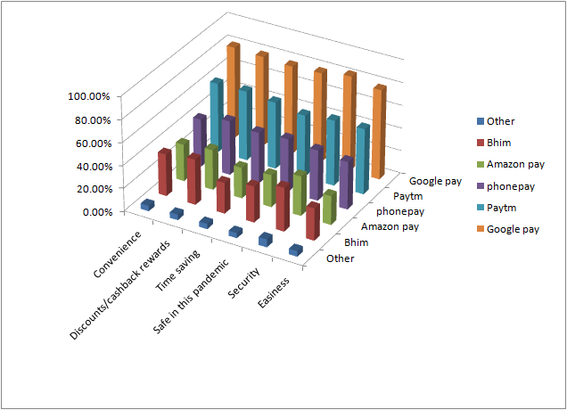

Slide 33
5) Objective: To check association between income and adoption of digital payment
Ho: There is no association between income and adoption of digital payment
H1: There is association between income and adoption of digital payment
 |  | Annual family income
 |  | Below 90,000 |  | Between 90,000 to 3 lakhs |  | Between 3 lakhs to 7 lakhs |  | Above 7 lakhs
 |  | Count | Column N % | Count | Column N % | Count | Column N % | Count | Column N %
why adopt? | Convenience | 44 | 55.7% | 70 | 69.3% | 46 | 79.3% | 22 | 81.5%
 | Discounts/cashback rewards | 37 | 46.8% | 38 | 37.6% | 21 | 36.2% | 7 | 25.9%
 | Time saving | 60 | 75.9% | 78 | 77.2% | 39 | 67.2% | 19 | 70.4%
 | Safe in this pandemic | 55 | 69.6% | 71 | 70.3% | 35 | 60.3% | 13 | 48.1%
 | Security | 30 | 38.0% | 45 | 44.6% | 29 | 50.0% | 11 | 40.7%
 | Easiness | 39 | 49.4% | 60 | 59.4% | 31 | 53.4% | 16 | 59.3%

Slide 34
Pearson Chi-Square Tests
 |  | Annual family income
why adopt? | Chi-square | 27.907
 | df | 18
 | Sig. | 0.063
Results are based on nonempty rows and columns in each innermost subtable.
Conclusion:
Since p-value > α(0.05), therefore the data provides the enough evidence to do not reject Ho at 5% level of significant and 18 df. Hence we conclude that there is no association between income and adoption of digital payment

Slide 35
6) Objective: Association between income and place where you use digital payment
Ho: There is no association between income and place where you use digital payment
H1: There is association between income and place where you use digital payment
 |  | Annual family income
 |  | Below 90,000 |  | Between 90,000 to 3 lakhs |  | Between 3 lakhs to 7 lakhs |  | Above 7 lakhs
 |  | Count | Column N % | Count | Column N % | Count | Column N % | Count | Column N %
place at which students use digital payment | Ticket booking | 52 | 65.8% | 62 | 61.4% | 39 | 67.2% | 21 | 77.8%
 | Bill payments | 47 | 59.5% | 71 | 70.3% | 44 | 75.9% | 19 | 70.4%
 | Paying fee | 62 | 78.5% | 77 | 76.2% | 45 | 77.6% | 20 | 74.1%
 | Mobile phone recharge | 61 | 77.2% | 77 | 76.2% | 46 | 79.3% | 20 | 74.1%
 | Petrol pump | 34 | 43.0% | 44 | 43.6% | 20 | 34.5% | 12 | 44.4%
 | Grocery store | 33 | 41.8% | 51 | 50.5% | 33 | 56.9% | 13 | 48.1%
 | Online shopping | 55 | 69.6% | 72 | 71.3% | 42 | 72.4% | 23 | 85.2%
 | Food payment | 32 | 40.5% | 31 | 30.7% | 31 | 53.4% | 16 | 59.3%
 | Investment | 16 | 20.3% | 22 | 21.8% | 16 | 27.6% | 4 | 14.8%
 | Insurance | 10 | 12.7% | 17 | 16.8% | 13 | 22.4% | 6 | 22.2%

Slide 36
Pearson Chi-Square Tests
 |  | Annual family income
place at which students use digital payment | Chi-square | 31.698
 | df | 30
 | Sig. | 0.382
Results are based on nonempty rows and columns in each innermost subtable.
Conclusion:
Since p-value > α(0.05), therefore we do not reject Ho at 5% level of significant and 30 df. Hence we conclude that there is no association between income and at which place do you use digital payment

Slide 37
Multiple Response Analysis
1) Reason for using digital payment
Adoption of digital payment Frequencies
 |  | Responses |  | Percent of Cases
 |  | N | Percent
adoption of digital paymentª | Convenience | 182 | 19.9% | 68.7%
 | Discounts/cashback rewards | 103 | 11.2% | 38.9%
 | Time saving | 196 | 21.4% | 74.0%
 | Safe in this pandemic | 174 | 19.0% | 65.7%
 | Security | 115 | 12.6% | 43.4%
 | Easiness | 146 | 15.9% | 55.1%
Total |  | 916 | 100.0% | 345.7%
a. Dichotomy group tabulated at value 1.
Observation :
From this table we observe that N column indicates the number of responses for each reason of using digital payment. The most common reason of usage of the digital payment is time saving. The percent of responses column indicates the percentage of responses of each reason to the total number of responses. The percent of cases indicate the percentage of number of respondents responded to the reason to the total number of respondents. Here each respondent can give one reason or more than one reason for using digital payment. Hence the total percentage of the number of respondents responded to each reason exceeds 100%.

Slide 38
2) Online payment application Preference
Application Frequencies
 |  | Responses |  | Percent of Cases
 |  | N | Percent
which application you use?ª | Google pay | 204 | 32.5% | 77.0%
 | Paytm | 157 | 25.0% | 59.2%
 | phonepay | 107 | 17.1% | 40.4%
 | Amazon pay | 70 | 11.2% | 26.4%
 | Bhim | 77 | 12.3% | 29.1%
 | Other | 12 | 1.9% | 4.5%
Total |  | 627 | 100.0% | 236.6%
a. Dichotomy group tabulated at value 1.
Observation:
We observe from our survey that maximum (77%) of students are using google pay application for online payment.

Slide 39
3) Different place of uses digital payment
Places Frequencies
 |  | Responses |  | Percent of Cases
 |  | N | Percent
at which place you use digital payment?ª | Ticket booking | 174 | 12.3% | 65.7%
 | Bill payments | 181 | 12.8% | 68.3%
 | Paying fee | 204 | 14.5% | 77.0%
 | Mobile phone recharge | 204 | 14.5% | 77.0%
 | Petrol pump | 110 | 7.8% | 41.5%
 | Grocery store | 130 | 9.2% | 49.1%
 | Online shopping | 192 | 13.6% | 72.5%
 | Food payment | 110 | 7.8% | 41.5%
 | Investment | 58 | 4.1% | 21.9%
 | Insurance | 46 | 3.3% | 17.4%
Total |  | 1409 | 100.0% | 531.7%
a. Dichotomy group tabulated at value 1.
Observation:
We observe from our survey that maximum (77%) of students are using digital payment for Paying fees and Mobile recharge.

Slide 40
4) Digital payment user influence by
Influence Frequencies
 |  | Responses |  | Percent of Cases
 |  | N | Percent
what influence you ?ª | Family | 142 | 23.2% | 53.6%
 | Friends | 150 | 24.5% | 56.6%
 | Demonetization | 94 | 15.4% | 35.5%
 | Advertisement | 112 | 18.3% | 42.3%
 | Pandemic | 114 | 18.6% | 43.0%
Total |  | 612 | 100.0% | 230.9%
a. Dichotomy group tabulated at value 1.
Observation:
We observe from our survey that maximum (56.6%) of students are Influence by friends for using digital payment

Slide 41
5) Reason for not using digital payment
Not using Digital Payment Frequencies
 |  | Responses |  | Percent of Cases
 |  | N | Percent
reason for not using digital paymentª | I have no bank account | 10 | 14.7% | 27.0%
 | Lack of knowledge | 8 | 11.8% | 21.6%
 | Concern about security | 19 | 27.9% | 51.4%
 | Family advise not to use | 12 | 17.6% | 32.4%
 | Friends advise not to use | 9 | 13.2% | 24.3%
 | Not required as much | 9 | 13.2% | 24.3%
 | Other | 1 | 1.5% | 2.7%
Total |  | 68 | 100.0% | 183.8%
a. Dichotomy group tabulated at value 1.
Observation:
We observe from our survey that maximum (51.4%) of students are not using digital payment because Concern about security.

Slide 42
Conclusion:
There are 88% users and 12 % Non-users of digital payment in the science faculty.
Male students (94%) are using more digital payment compare to female(88%).
The main reason for adopting digital payment is time saving.
Most off students are using digital payment for mobile phone recharge and paying fee.
Almost 77% of students are using google pay application for digital payment.
Fraud(48% ) and privacy(48%) is the biggest concern while using digital payment.
Due to covid-19 8% of students were started to use digital payment.
51 % of students are agree that digital payment is safe.
14% of students are facing fraud.
Students who are not using digital payment their main reason is concern about security.
The students who currently not using digital payment, 97% of them will use in future.

Slide 43

Questionnaire
Click Here

Slide 44
Refrence
Bezhovski, Z. (2016). “The Future of the Mobile Payment as Electronic Payment System” ,European Journal of Business and Management.
Singh., S. (2017). “Study on consumer perception of Digital Payment mode”,Journal ofInternet Banking and Commerce”, 22(3), December.
Adeoti, O. & Osotimehin, K. (2012). Adoption of Point of Sale Terminals in Nigeria: Assessment of Consumers' Level of Satisfaction. Research Journal of Finance and Accounting.
https://www.researchgate.net/publication/336835369_An_Overview_On_Digital_Payments
https://www.ijcrt.org/papers/IJCRT2102051.pdf
http://programmer2programmer.net/tips/smu/smu_project_description.aspx?id=472&course=MBA&type=Finance
https://www.researchgate.net/publication/34251733_Electronic_payment_systems_a_user-centered_perspective_and_interaction_design

Slide 45
https://forms.gle/XrJyERFpsDYECLRT6
https://www.jstor.org/stable/2981454?seq=1#metadata_info_tab_contents
https://www.managementstudyguide.com/digital-payments-pros-and-cons.htm
https://main.mohfw.gov.in/digital-payment
https://www.studocu.com/in/document/maulana-abul-kalam-azad-university-of-technology/knowledge-management/mandatory-assignments/epayment-project/5324514/view
https://timesofindia.indiatimes.com/blogs/voices/digital-payments-a-success-story/
https://www.objectiveias.in/status-of-digital-payments-in-india/
https://www.researchgate.net/publication/318076004_A_Survey_on_E-Payment_Systems_Elements_Adoption_Architecture_Challenges_and_Security_Concepts
https://www.digipay.guru/blog/electronic-payment-systems/

Slide 46
Thank you

